Slide 1

Problem Statement
Objective:
To develop a machine learning model that:
Predicts whether a customer is likely to churn
Uses behavioral & demographic features from internal datasets
Supports early intervention strategies by the retention team
Business Need: EXL’s Credit Card Analytics Division has observed declining customer retention in specific segments. Proactively identifying potential churners can help reduce revenue loss and improve customer engagement.
POC Goal:
Build an ML-driven solution to:
Classify churners vs non-churners
Visualize key insights and drivers of churn
Simulate production-ready project architecture (locally in this case) Trainer: Aun Kumar Ganiger
Submitted By: Isha Goyal
Github: https://github.com/1007Isha/-exl-credit-churn-analysis

Slide 2
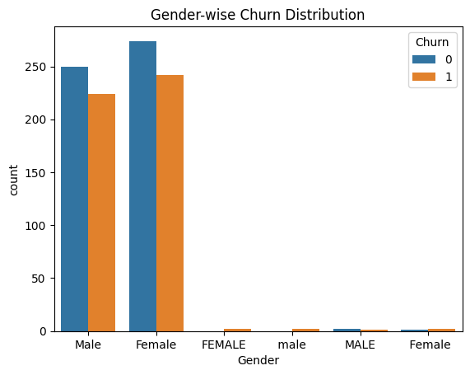
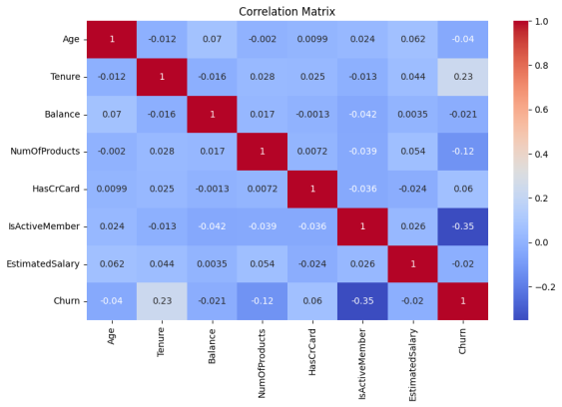
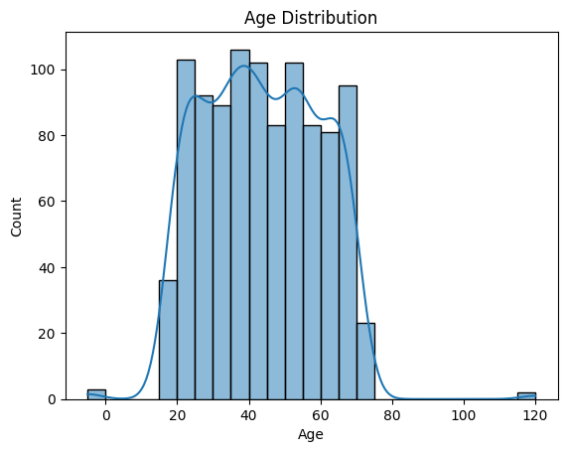
EDA Summary
Exploratory Insights:
Churn Rate: Balanced classes, slight skew toward non-churners
Age & Churn: Middle-aged customers churn more
Gender Distribution: No strong bias in churn rate by gender
Key Visuals:
Churn Distribution
Gender vs Churn
Age Distribution
Correlation Matrix
https://github.com/1007Isha/-exl-credit-churn-analysis/tree/main/feature/eda

Slide 3
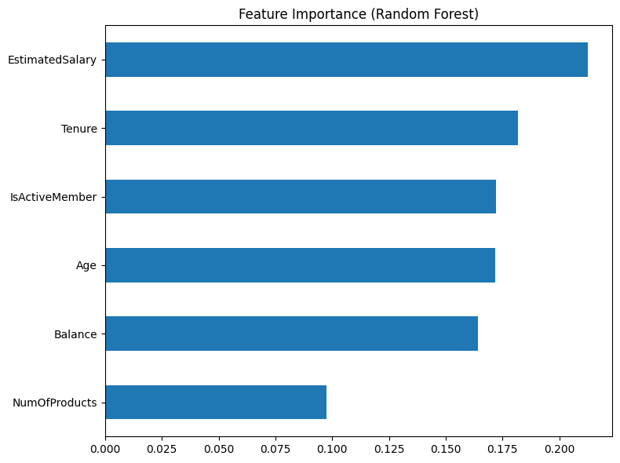
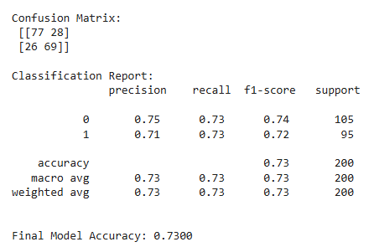
Model Output
Model Used: Random Forest Classifier
Preprocessing:
One-Hot Encoding (for categorical features)
MinMaxScaler (for numeric features)
Evaluation Metrics:
Accuracy: 73%
Precision, Recall, F1-Score: Balanced
Confusion Matrix & Feature Importance plotted
Model saved as churn_model_improved.pkl

Slide 4

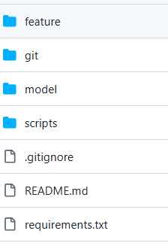
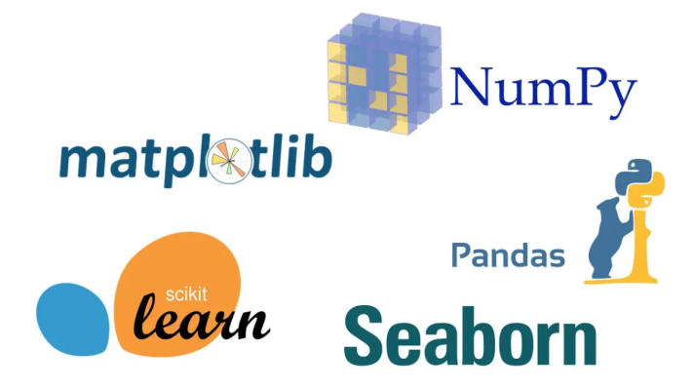
Execution Environment (Local Setup)
Platform Used: Google Colab (Python 3.9+, scikit-learn, pandas, seaborn)
Modular Directory Structure:
data/ → Raw and processed data
scripts/ → All preprocessing, model training, and prediction scripts
model/ → Saved model and evaluation metrics
feature/eda and feature/ml → Visualizations and plots
Version Control:
Project tracked using Git & GitHub with branching structure:
main, dev, feature/eda, feature/ml, presentation
https://github.com/1007Isha/-exl-credit-churn-analysis

Slide 5


Final Recommendations
Business Suggestions:
Focus on customers who:
Use their account very little
Have low balance and low salary
Use many products but are not active now
Model Improvement Ideas:
Add real-time data for better predictions
Deploy the model using AWS in future
Try more advanced tuning to improve accuracy
Show results on a live dashboard for business teams
Key Takeaway:
The model gives useful results and can be made better by adding cloud features and automation in the next steps.

